Slide 1
Market Basket Analysis
Frequent pattern mining/frequent itemset mining/association rule mining

Slide 2
What is Frequent Pattern Analysis?
Frequent pattern: a pattern (a set of items, subsequences, substructures, etc.) that occurs frequently in a data set
Motivation: Finding inherent regularities in data
What products were often purchased together?— Bread and Eggs?!
What are the subsequent purchases after buying a PC?
What kinds of DNA are sensitive to this new drug?
Applications
Basket data analysis, cross-marketing, catalog design, sale campaign analysis, Web log (click stream) analysis, and DNA sequence analysis.

Slide 3
Why do Market Basket Analysis?
With automated point of sale systems, stores have data of all the items purchased together
Objective: Mine that data to find the items that are frequently purchased together
Market Basket Analysis is one of the key techniques used by large retailers to uncover associations between items.

Slide 4


Market Basket Analysis

Slide 5
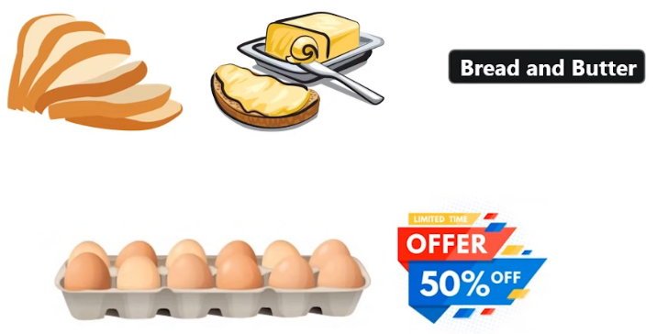
Market Basket Analysis

Slide 6
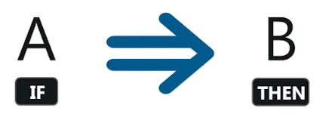
Association Rule Mining
“if-then” relationship
If an item or group of items “A” is purchased, what are the chances that item “B” will also be picked up by the customer under same transaction id
Antecedent
Consequent
Caution: Reverse might not be true with the same level of confidence/probability!

Slide 7
Transactional Data for Association Rule Mining
Tid | Items bought
10 | Milk, Nuts, Diaper
20 | Milk, Coffee, Diaper
30 | Milk, Diaper, Eggs
40 | Nuts, Eggs, Milk
50 | Nuts, Coffee, Diaper, Eggs, Milk
Tid | Items
10 | A, C, D
20 | B, C, E
30 | A, B, C, E
40 | B, E
More General Form of Items

Slide 8
Finding Frequent Item Sets
Finding Frequent Item Sets
Apriori Algorithm
FP Growth Algorithm

Slide 9
Apriori Algorithm
For Association Rule Mining

Slide 10
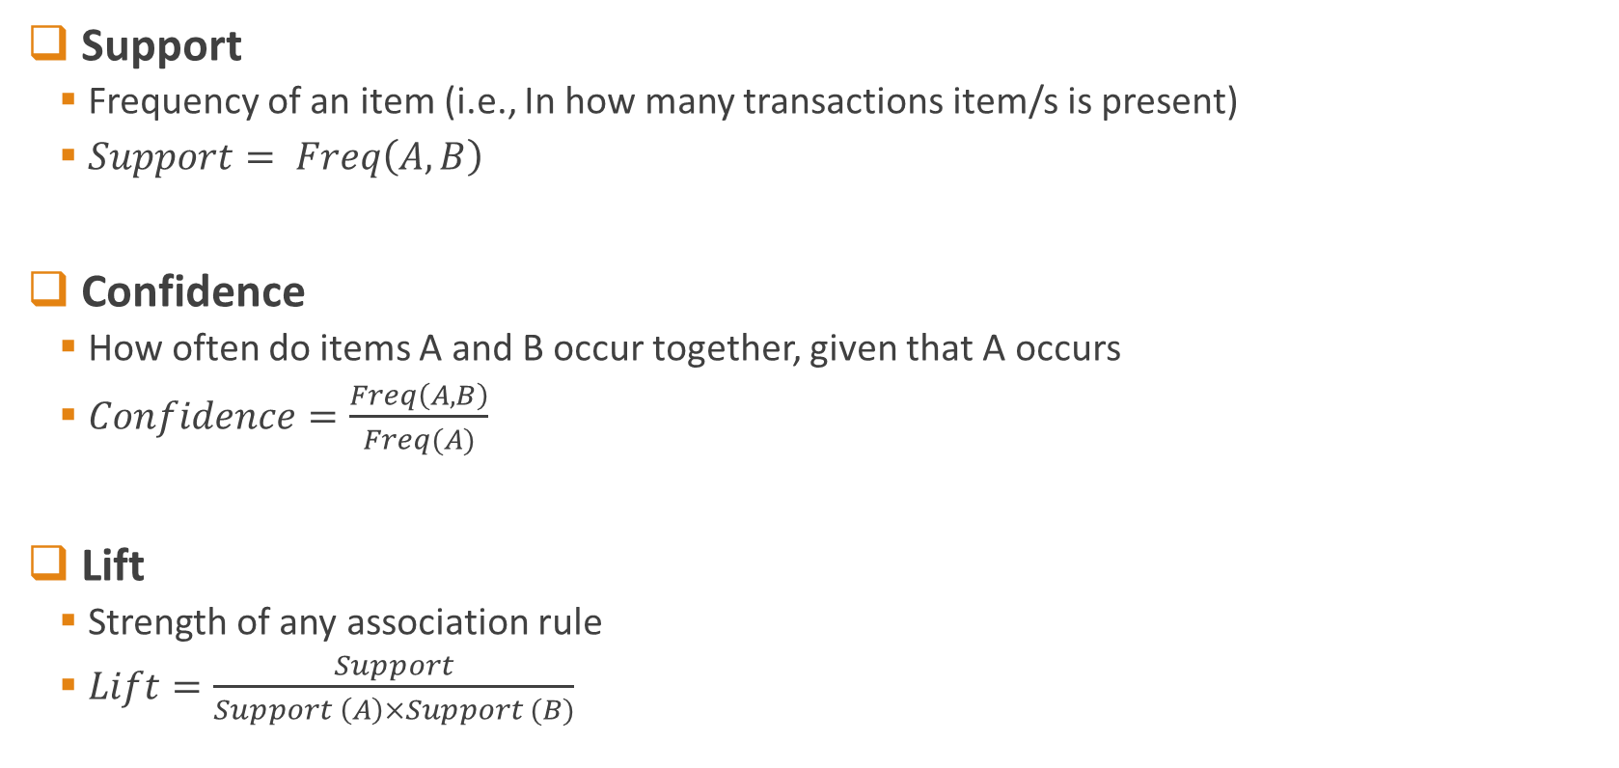
Apriori: Preliminary Terms
Support
Frequency of an item (i.e., In how many transactions item/s is present)
$Support= Freq\left(A,B\right)$
Confidence
How often do items A and B occur together, given that A occurs
$Confidence=\frac{Freq\left(A,B\right)}{Freq(A)}$
Lift
Strength of any association rule
$Lift=\frac{Support}{Support \left(A\right)×Support (B)}$

Slide 11
Apriori Algorithm
Uses frequent itemsets to generate association rules
It is based on the concept that a subset of a frequent itemset must also be a frequent itemset
Frequent itemset is an itemset whose support value is greater than a threshold value

Slide 12






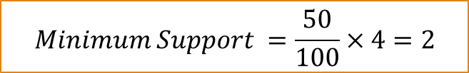
Apriori Example: Find Candidates and Frequent Item Sets
Tid | Items
1 | A, B, C
2 | A,C
3 | A,D
4 | B,E,F
Items | Support
{A} | 3
{B} | 2
{C} | 2
{D} | 1
{E} | 1
{F} | 1
Items | Support
{A, B} | 1
{B, C} | 1
{A, C} | 2
$$Candidate_{1}=$$
$$Candidate_{2}=$$
$$L_{2}$$
Items | Support
{A, C} | 2
$$L_{1}$$
Items | Support
{A} | 3
{B} | 2
{C} | 2
$$Minimum Support = 50\%$$
$$Minimum Support =\frac{50}{100}×4=2$$
$$Minimum Confidence = 50\%$$

Slide 13
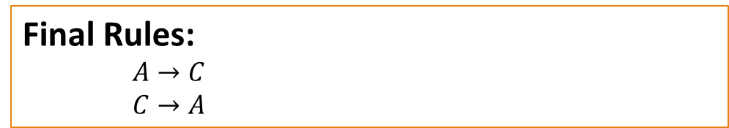
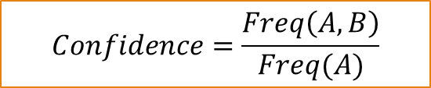
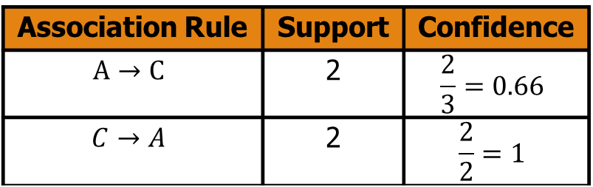
Apriori Example: Find Candidates Association Rules
Tid | Items
1 | A, B,C
2 | A,C
3 | A,D
4 | B,E,F
Items | Support
{A, C} | 2
Association Rule | Support | Confidence
$$A→C$$ | 2 | $$\frac{2}{3}=0.66$$
$$C→A$$ | 2 | $$\frac{2}{2}=1$$
Now Select all the rules that have confidence higher than “Minimum Confidence”
Final Rules:
$A→C$
$C→A$
$$Minimum Support = 50\%$$
$$Minimum Support =\frac{50}{100}×4=2$$
$$Confidence=\frac{Freq\left(A,B\right)}{Freq(A)}$$
$$Minimum Confidence = 50\%$$

Slide 14
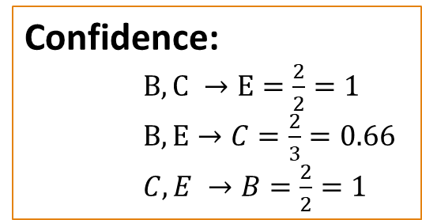
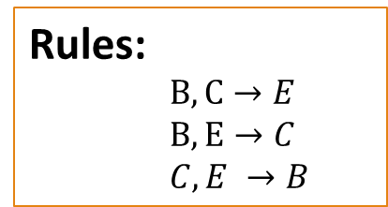
Example 2
Itemset | sup
{A} | 2
{B} | 3
{C} | 3
{D} | 1
{E} | 3
Database TDB
Itemset | sup
{A} | 2
{B} | 3
{C} | 3
{E} | 3
Sup_{min} = 2
L₁
Tid | Items
10 | A, C, D
20 | B, C, E
30 | A, B, C, E
40 | B, E
C₁
1st scan
Rules:
$B,C→E$
$B,E→C$
$C,E →B$
C₂
Itemset | sup
{A, B} | 1
{A, C} | 2
{A, E} | 1
{B, C} | 2
{B, E} | 3
{C, E} | 2
C₂
Itemset
{A, B}
{A, C}
{A, E}
{B, C}
{B, E}
{C, E}
L₂
Itemset | sup
{A, C} | 2
{B, C} | 2
{B, E} | 3
{C, E} | 2
2nd scan
Confidence:
$B,C →E=\frac{2}{2}=1$
$B,E→C=\frac{2}{3}=0.66$
$C,E →B=\frac{2}{2}=1$
C₃
Itemset
{B, C, E}
3rd scan
L₃
Itemset | sup
{B, C, E} | 2

Slide 15







Example 3
Min_Support = 2
$$C_{1}$$
$$L_{1}$$
$$C_{2}$$
Tid | Items
1 | 1,3,4
2 | 2,3,5
3 | 1,2,3,5
4 | 2,5
5 | 1,3,5
Itemset | Support
{1} | 3
{2} | 3
{3} | 4
{4} | 1
{5} | 4
Itemset | Support
{1} | 3
{2} | 3
{3} | 4
{5} | 4
Itemset | Support
{1,2} | 1
{1,3} | 3
{1,5} | 2
{2,3} | 2
{2,5} | 3
{3,5} | 3
$$C_{3}$$
$$L_{2}$$
$$L_{3}$$
$$C_{4}$$
Itemset | Support
{1,3,5} | 2
{2,3,5} | 2
Itemset | Support
{1,2,3} | 1
{1,2,5} | 1
{1,3,5} | 2
{2,3,5} | 2
Itemset | Support
{1,3} | 3
{1,5} | 2
{2,3} | 2
{2,5} | 3
{3,5} | 3
Itemset | Support
{1,2,3,5} | 1

Slide 16
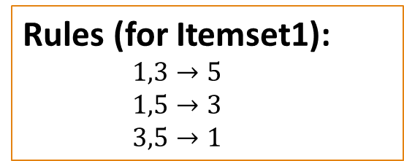

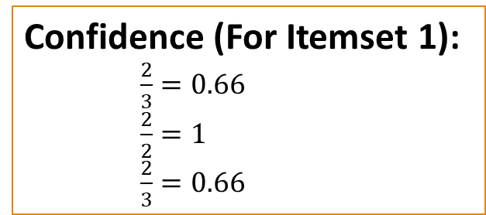
Example 3
Min_Support = 2
$$L_{3}$$
Tid | Items
1 | 1,3,4
2 | 2,3,5
3 | 1,2,3,5
4 | 2,5
5 | 1,3,5
Itemset | Support
{1,3,5} | 2
{2,3,5} | 2
Rules (for Itemset1):
$1,3→5$
$1,5→3$ $3,5→1$
Rules (for Itemset2):
Homework (Ungraded)
Confidence (For Itemset 1):
$\frac{2}{3}=0.66$
$\frac{2}{2}=1$
$\frac{2}{3}=0.66$
Confidence (For Itemset 2):
Homework (Ungraded)

Slide 17
Book Reading
Chapter 6

